Slide 1
SNAKE:
CHICKEN EDITION
Made by: Anna Tran, Ethan Tran, Ishi Tripathi

Slide 2
Designs
We wanted a game that was not difficult to recreate but put a slight twist on
Many ideas for the “snake”
Long vs Many
Goals
Working game
Start menu and end screen
Music

Slide 3
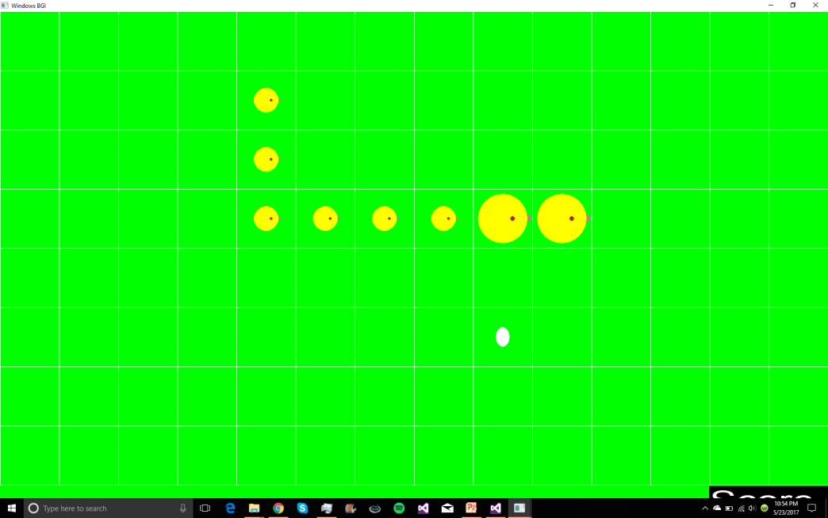
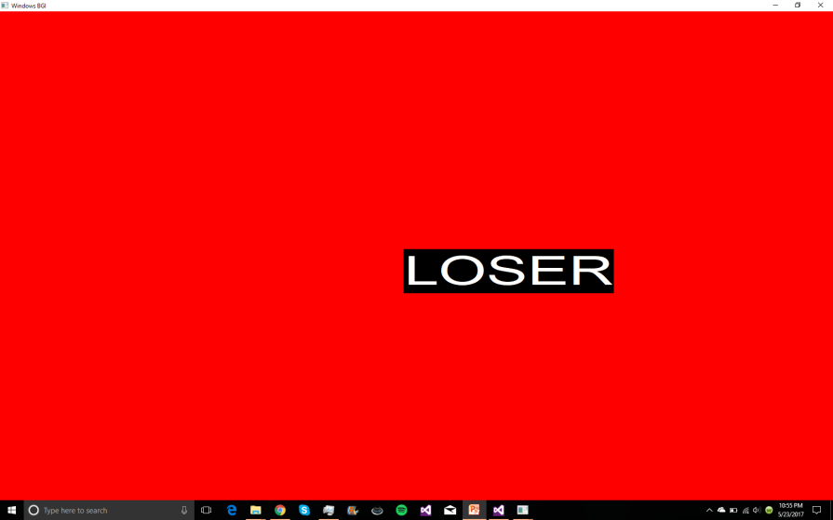
Screenshots

Slide 4
Problems
Having the chick follow the chicken
Redrawing chicken
How to end the game by running into yourself/ other chicks
Using too many variables instead of arrays or vectors
As the number of chicks increased there was increasing amount of “random deaths”

Slide 5
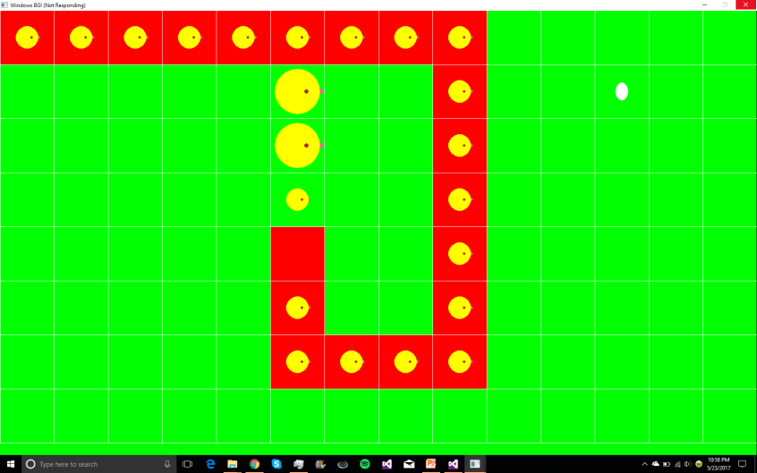
Early build

Slide 6
Solutions
Grid system, 16 x 9 with 120 pixels apart creating a 120 x 120 pixel box
We drew boxes over the position of the mama chick and then proceed to draw the “smol” chick at the location of the mama chick before it had moved
Increasing the amount of collision checks to attempt to die less

Slide 7
Unimplemented Ideas
No music
Unlimited smol chicks
Ending screen that restarts the game

Slide 8
Improvements
Using vectors instead of hardcoding
Better time management
Have different people code different tasks simultaneously

Slide 9
Questions?
Feel free to ask one to any of us

